Slide 1





PE Development Fund
16/17 Showcase
November 23rd 2017
Hanna Kovshoff
hk@soton.ac.uk
acornsnetwork@soton.ac.uk
@AcornsNetwork
www.acornsnetwork.org.uk
www.facebook.com/Acorns.southampton

Slide 2

What is ACoRNS?
Improve the lives of children and young people on the autism spectrum
Transitions and trajectories in education
Children with autism
Schools
Families
Community
Researchers

Slide 3
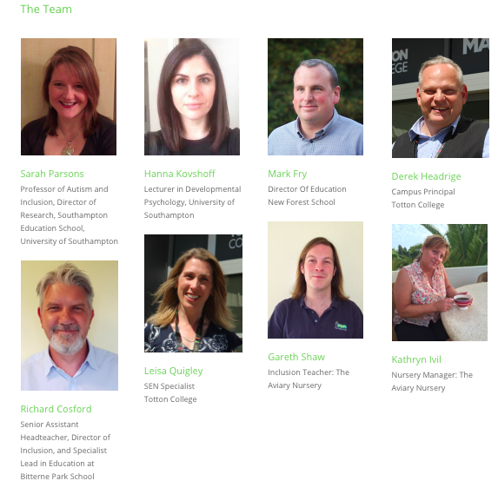
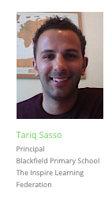
ACoRNS Partners

Slide 4
The ACoRNS Mission
Our agreed priorities are educational ‘transitions and trajectories’ with a focus on ‘hearing’ voices
Working together to decide what questions can be addressed by research and that matter to practitioners
Researching those questions
Feeding back
Improving and reflecting on practice
Sharing practice and knowledge

Slide 5
Project launch: June 27th 2017
From community → research
Key issues around transitions and trajectories
5 linked student projects this year
Across different settings and age groups
Focus on children’s experiences and voices
How do we listen and what do we hear?

Slide 6

The voices and experiences of children with autism, and their families, in their transitions from nursery to primary school
Sarah Parsons, Hanna Kovshoff, Kathryn Ivil, Gareth Shaw and Effie Karakosta
University of Southampton + Aviary Nursery
£35K funding

Slide 7

Hearing autistic children’s voices in education
Thursday 9th November 2017
2-4pm
Totton College
acornsnetwork@soton.ac.uk
@AcornsNetwork
www.acornsnetwork.org.uk
www.facebook.com/Acorns.southampton

Slide 8
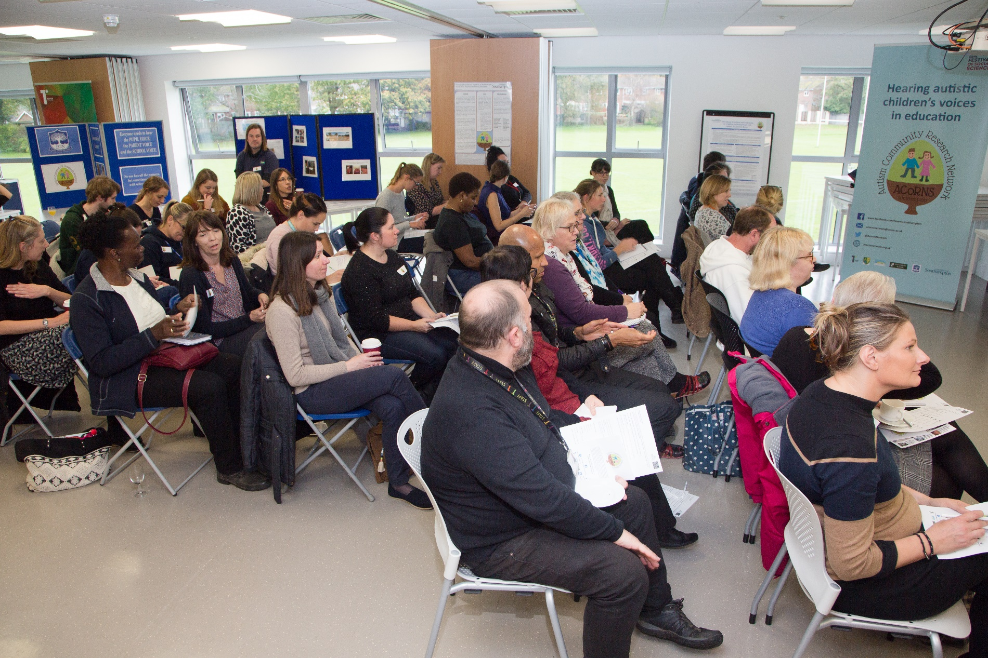
Hearing autistic children’s voices in education

Slide 9
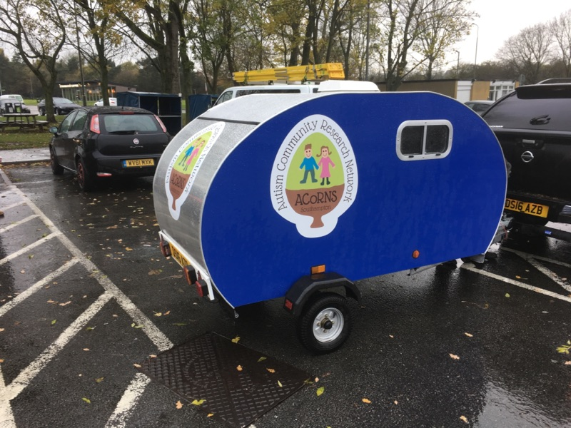
The ACoRNS Listening Pod!

Slide 10
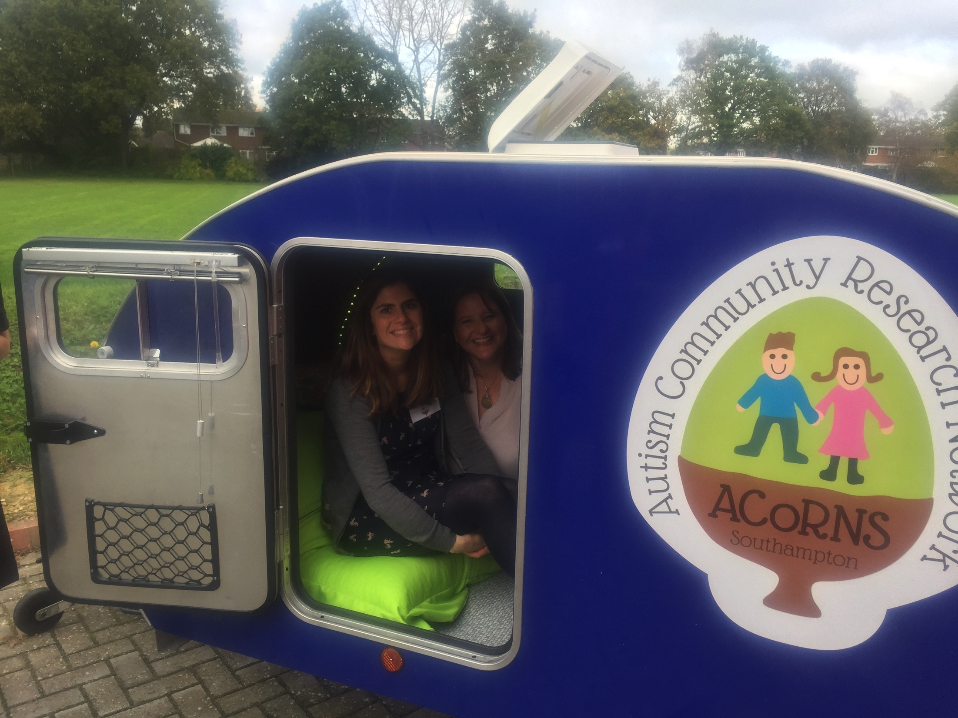
The ACoRNS Listening Pod!

Slide 11
Piloting the Pod!
What questions should we be asking?
How can we support the diversity of voices?
How can we best make use of the pod?

Slide 12
The importance of listening to the voices of children with autism in education
Autism Units in Mainstream Schools Across Europe (AMUSE) - Valencia, Spain
November 24th 2017
Autism Units in Mainstream Schools Across Europe (AMUSE) - Valencia, Spain
November 24th 2017
Professor Sarah Parsons
Southampton Education School
S.J.Parsons@soton.ac.uk

Slide 13
PE Development Fund
16/17 Showcase
November 23rd 2017
Hanna Kovshoff
hk@soton.ac.uk
acornsnetwork@soton.ac.uk
@AcornsNetwork
www.acornsnetwork.org.uk
www.facebook.com/Acorns.southampton

